Slide 1
InfluxDB A State of the Art Time Series Database
An INFSCI 2711 Lab
by
Yichi Zhang
Quan Zhou
Notes:
Good afternoon everyone, I’m Yichi Zhang.
Today Quan and I will be giving you a special lab about Time Series Database, which will use InfluxDB as an example.

Slide 2
Outline
Intro to Time Series Database
Intro to InfluxDB
Installation
Basic Operations
Data Exploration
Data Analysis with Grafana
Notes:
Here is the outline of this lab, firstly we will go through some basic concepts.

Slide 3
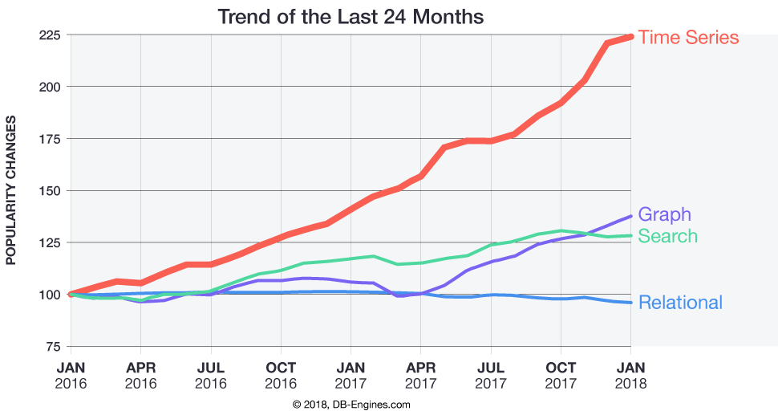
Trending in the Database Industry
Notes:
This graph shows the trending in the db industry, as we can see the time series db are attracting more attention than ever recently.
So here comes some questions, what can we do with time series dbs? And what is time series dbs?

Slide 4
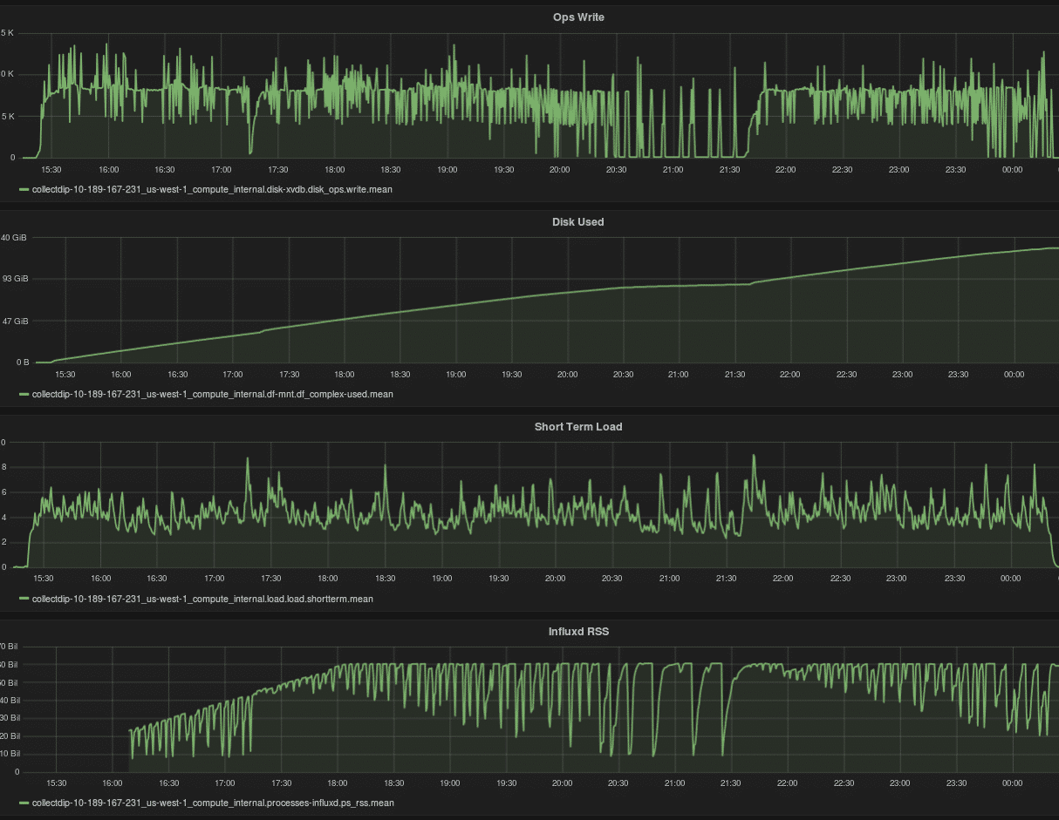
Time Series Database (TSDB)
A database optimized for time-stamped or time series data
Server metrics
Financial data
Weather data
Industrial machine data
Auto-piloting cars
Notes:
So a time series db is a db (读)
And it has already been widely applied to monitoring real-time data, like server metrics, financial data, weather data and so on.

Slide 5
Why TSDB?
Relational databases are originally designed for OLTP (e.g. bank transactions)
Strong and useful features of RDBMS
Secondary index support
Rich query language
Multi-table JOINs
The problems of RDBMS
SCALING
PERFORMANCE
Notes:
Why we have to use time series db for time series data? Why the traditional db are not capable of this?
The RDB(读).
But RDBMS have some key disadvantages, that is scaling and performance, which is crucial for time series data.
Why it’s crucial for time series data? We have to understand the nature of time series data.

Slide 6


Why TSDB?
Time-series data accumulates very quickly
A auto-piloting car collects 25GB of data per hour
A 10,000 machine datacenter easily generates 1,000,000,000 system status data points per day
Notes:
Time-series data accu.(读所有)
Most of the data are quite simple, like: numbers or text, which are some primitive data types.

Slide 7
RDBMS vs. TSDB
OLTP Writes
Primarily UPDATES
Randomly distributed (over the set of primary keys)
Often transactions across multiple primary keys
Time-series Writes
Primarily INSERTs
Primarily to a recent time interval
Primarily associated with both a timestamp and a separate primary key (e.g., server ID, device ID, security/account ID, vehicle/asset ID, etc.)
Notes:
With the special nature of time series data, we can compare the writing process between RDBMS and time series DB.
(读两张表)
In order to adapt to these differences, we have to develop a new type of db, that’s time series database.

Slide 8
Popular TSDBs
InfluxDB
Written in Go
OpenTSDB
Built on top of HBase
KDB+
Column-based relational TSDB with in-memory capabilities
Graphite
Data logging and graphing tool for time series data, numeric data only
Notes:
（~7分钟）
There are some famous time series database.
InfluxDB is the one we are going to cover, it’s written in Go, which is the same as MongoDB, but much faster.
(读+发挥)

Slide 9
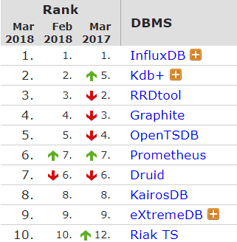
Why InfluxDB
Most popular Time-series database
Widely deployed in the industry
https://www.influxdata.com/customers/testimonials/
Excellent performance
Top 3 in all categories
Write performance
Query speed
Data compression (Storage)
Easiness of use
SQL like queries
Best functionality
Best Overall Score
Notes:
Among all those popular time series dbs, why we choose InfluxDB?
According to db-engines dot com, it’s the most popular (读左上方)
Also, influxDB has been widely deployed in the industry.
（读+发挥）

Slide 10
Installation & Starting InfluxDB on Mac OS
Install Homebrew (if you don’t already have it)
/usr/bin/ruby -e "$(curl -fsSL https://raw.githubusercontent.com/Homebrew/install/master/install)"
Update Homebrew repo and install InfluxDB
brew update
brew install influxdb
Getting Started
From terminal / cmd, start the service with
influxd
Open another window and connect to the shell with
influx -precision rfc3339
Notes:
Now it’s time to explore the InfluxDB. I hope you all have the db installed.
Quan will take over, and I will be solving your problems during the following process. Ask me if you have any problems.

Slide 11
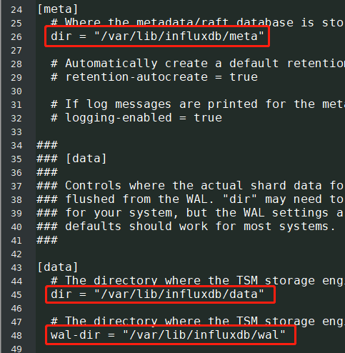
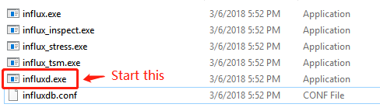
Installation & Starting InfluxDB on Windows
Download and unzip the package from
https://dl.influxdata.com/influxdb/releases/influxdb-1.5.0_windows_amd64.zip
Unzip 'influxdb-1.5.0_windows_amd64.zip'
Modify 'influxdb.conf' as you like
Start 'influxd.exe'
Start 'influx.exe'

Slide 12
Basic Terminologies of InfluxDB
MySQL | InfluxDB
database | database
table | measurement
row | point / series
index | tag (string)
column | field (string | boolean | integer | float)

Slide 13
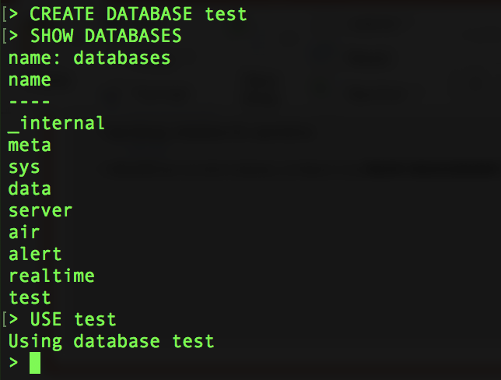
Basic Operations
Creating a database
CREATE DATABASE test
SHOW DATABASES
Specifying a database for operations
USE test
InfluxDB has no strict schema, so there is no such statement as CREATE MEASUREMENT

Slide 14
Data Insertion
Insert data
INSERT server,region=us_east,host=server_A cpu=0.65,mem=2335
INSERT server,region=us_east,host=server_A cpu=0.53 1521028800000000000
INSERT server,region=us_east cpu=0.43,mem=3532 1521028800000000000
INSERT server,region=us_east,host=server_B cpu=0.33,mem=3323 1521028500000000000
If no timestamp is specified, the current system time will be used.
All the syntax (the commas and whitespaces indicating measurement, tags and fields) in the INSERT query should be strictly followed!
SELECT * FROM server
measurement tags fields timestamp (in nanoseconds)

Slide 15
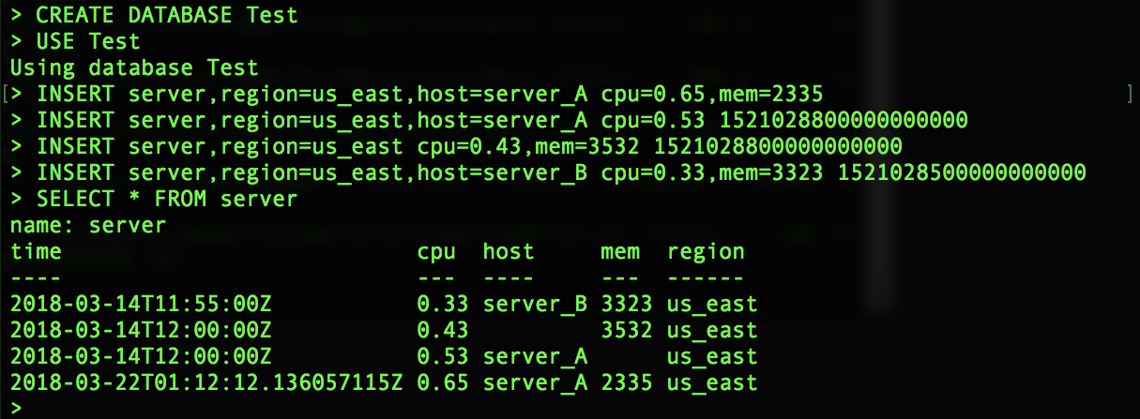
Data Insertion

Slide 16
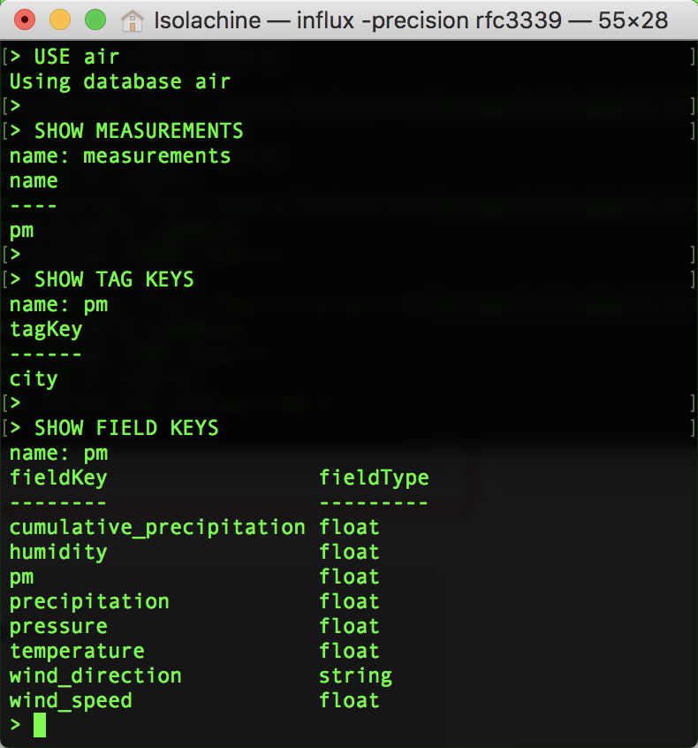
Data Exploration
Import sample data
The air quality measure of 5 Chinese cities from 2010 to 2015 (https://archive.ics.uci.edu/ml/datasets/PM2.5+Data+of+Five+Chinese+Cities)
Mac OS: Run the shell script provided in terminal: sh scripts/import_mac_linux.sh
Windows
Copy influx.exe into the scripts folder
Execute import_windows.bat
Data schema exploration
USE air
SHOW MEASUREMENTS
SHOW TAG KEYS
SHOW FIELD KEYS

Slide 17
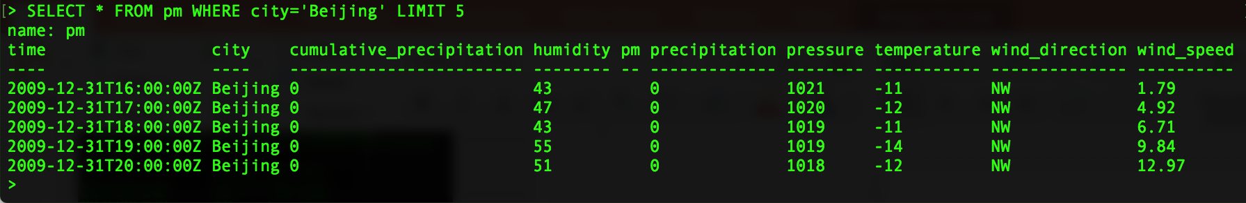
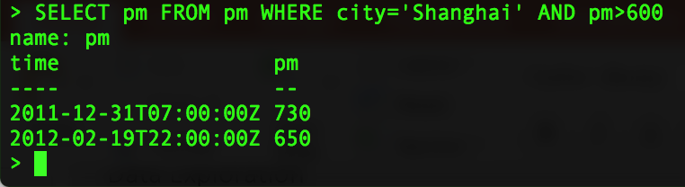
Data Exploration
Simple SELECT Queries
Select the first 5 records of Beijing
SELECT * FROM pm WHERE city = 'Beijing' LIMIT 5
Select all the records of Shanghai where PM2.5 exceeds 600
SELECT pm FROM pm WHERE city = 'Shanghai' AND pm > 600

Slide 18
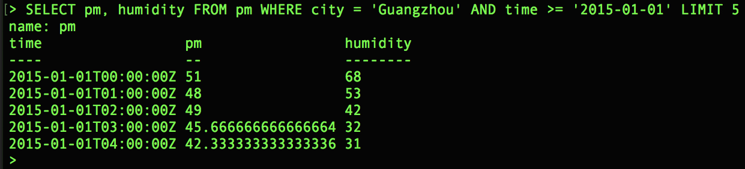
Data Exploration
Simple SELECT Queries
Select the first 5 PM2.5 and humidity of Guangzhou starting from 01/01/2015
SELECT pm, humidity FROM pm WHERE city = 'Guangzhou' AND time >= '2015-01-01' LIMIT 5
Important: Tag values and field string values in WHERE clause should be wrapped by SINGLE QUOTES

Slide 19
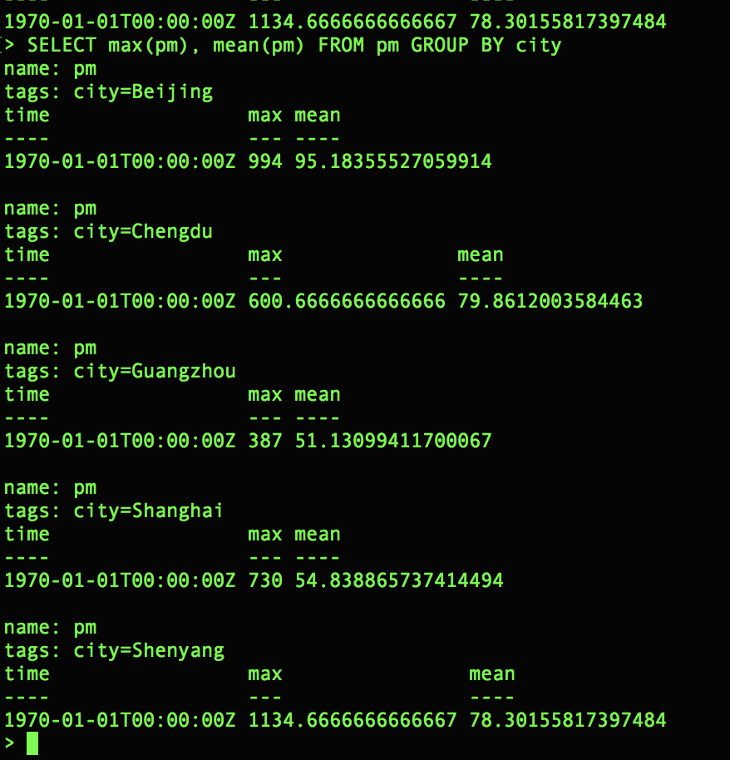
Data Exploration
OLAP queries
Return the mean and max of PM2.5 by each city from all time
SELECT max(pm), mean(pm) FROM pm GROUP BY city

Slide 20
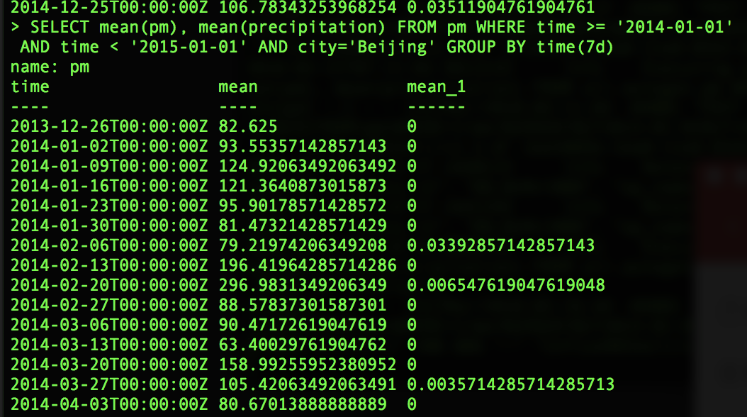
Data Exploration
OLAP queries (GROUP BY time interval)
Return the mean of PM2.5 and precipitation in Beijing for every 2 weeks in the year of 2014
SELECT mean(pm), mean(precipitation) FROM pm WHERE time >= '2014-01-01' AND time < '2015-01-01' AND city='Beijing' GROUP BY time(7d)

Slide 21
Influx Data PLATFORM
Visualization
3rd Party
Visualization
& Analysis
Data Input Flow
Data Storage
Analysis

Slide 22
Grafana Installation
Mac OS
Installation
brew update
brew install Grafana
Startup
brew services start Grafana
Window
Download Package
http://docs.grafana.org/installation/windows/
Unzip & Run
bin/grafana-server.exe

Slide 23
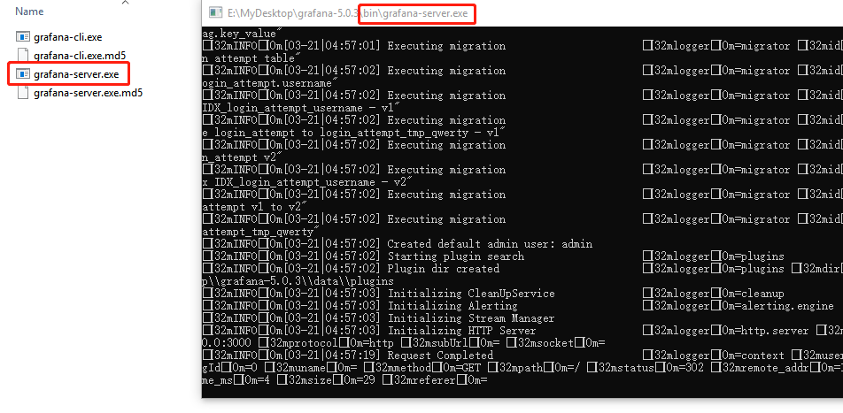
Start Grafana on Windows

Slide 24

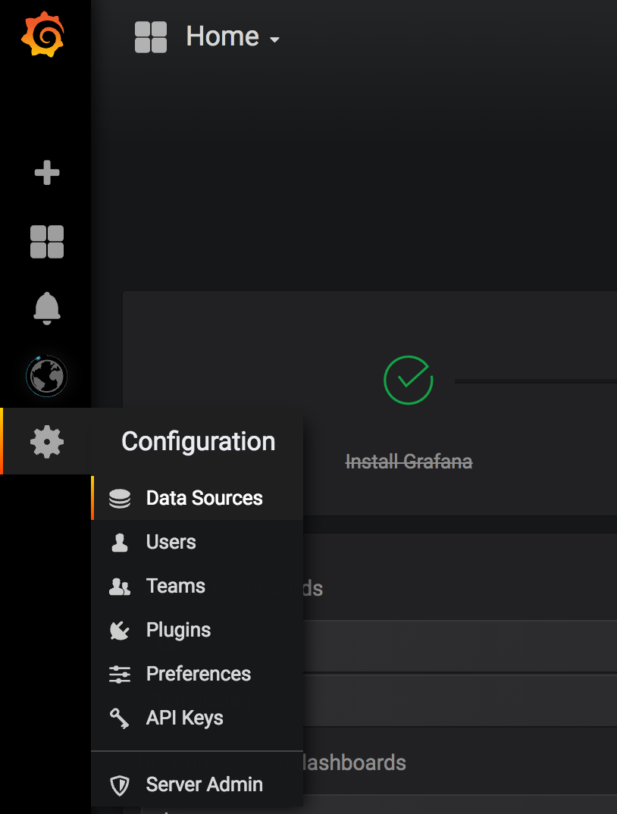
Visualize Data with Grafana
Access the web interface
localhost:3000
Login with admin/admin

Slide 25
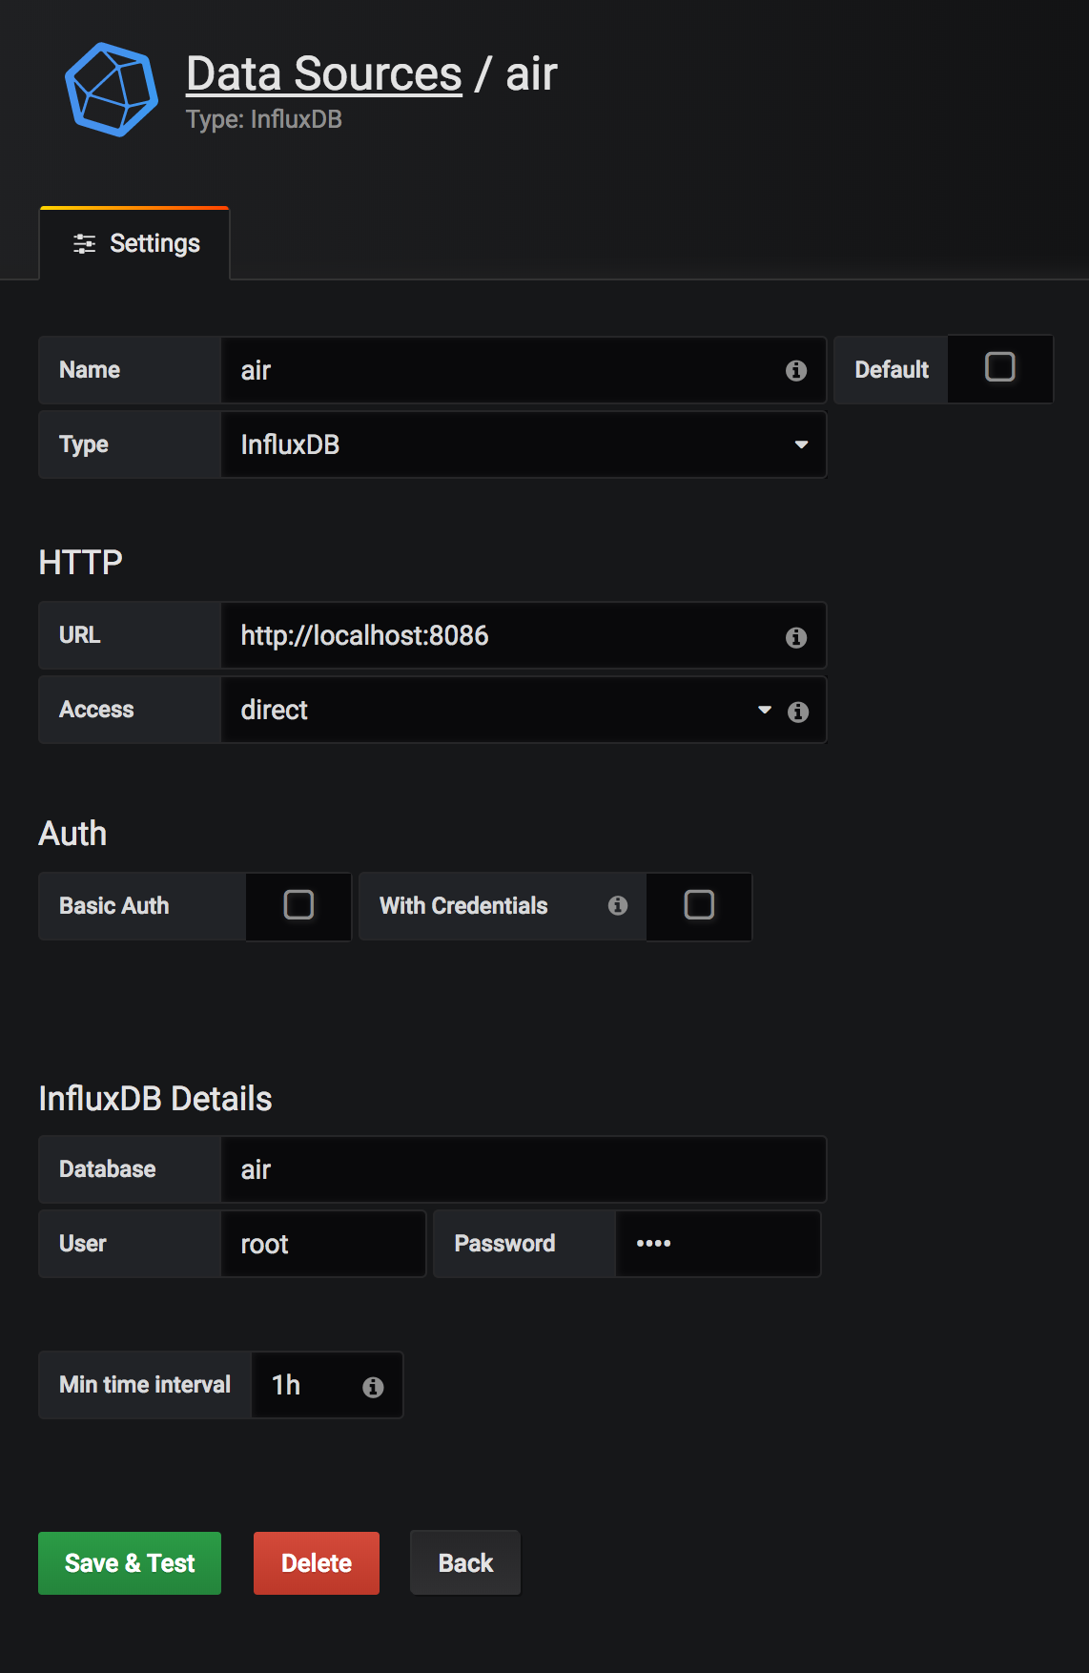
Visualize Data with Grafana
Access the web interface
localhost:3000
Login with admin/admin
Set up data source
User: root
Password: root
Database: air

Slide 26
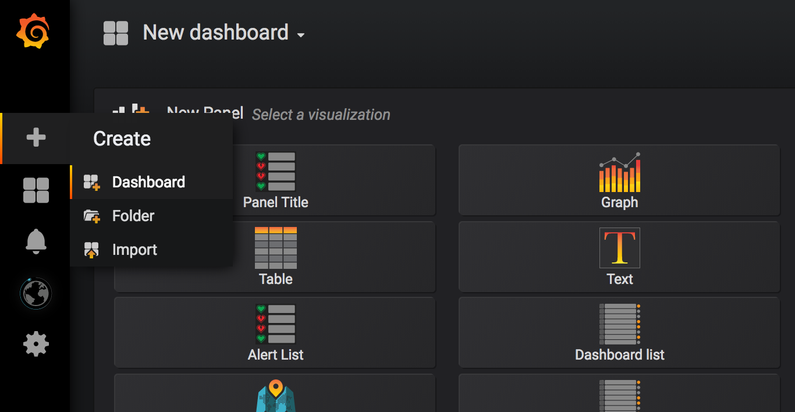
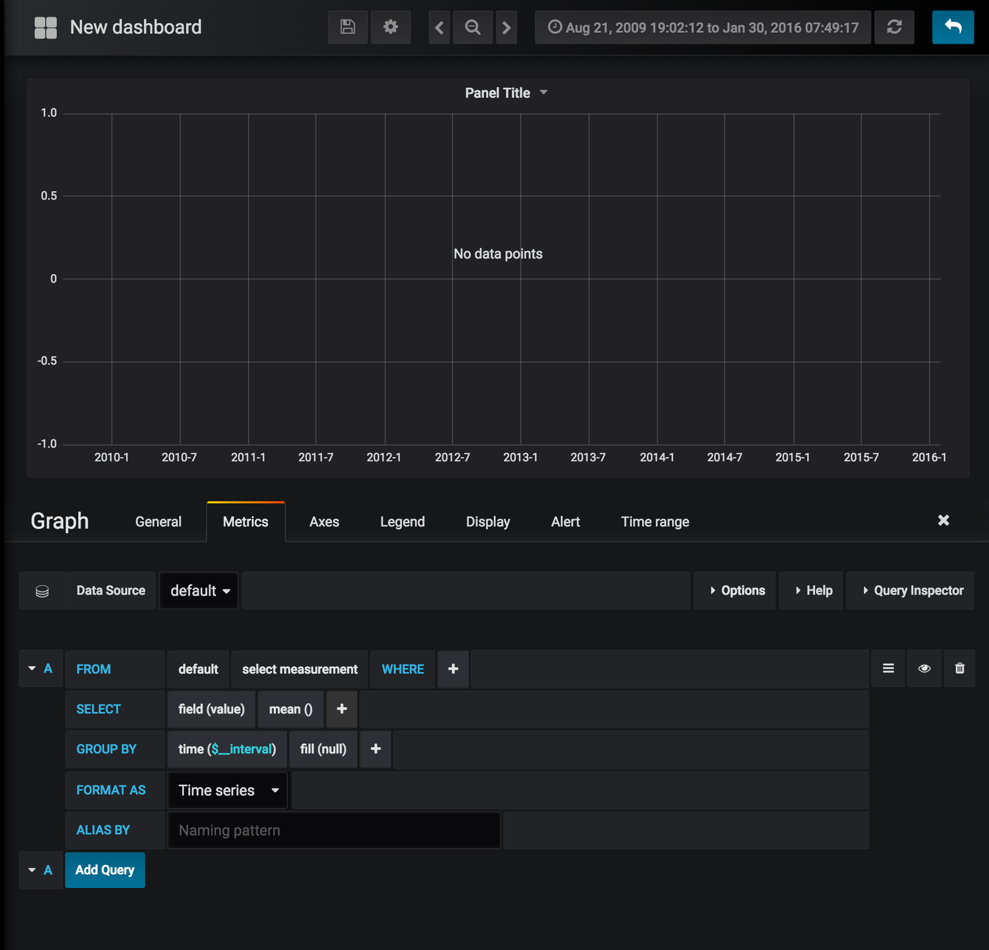
Visualize Data with Grafana
Access the web interface
localhost:3000
Login with admin/admin
Set up data source
User: root
Password: root
Database: air
Create a new dashboard
Add a new graph panel
Start editing panel

Slide 27
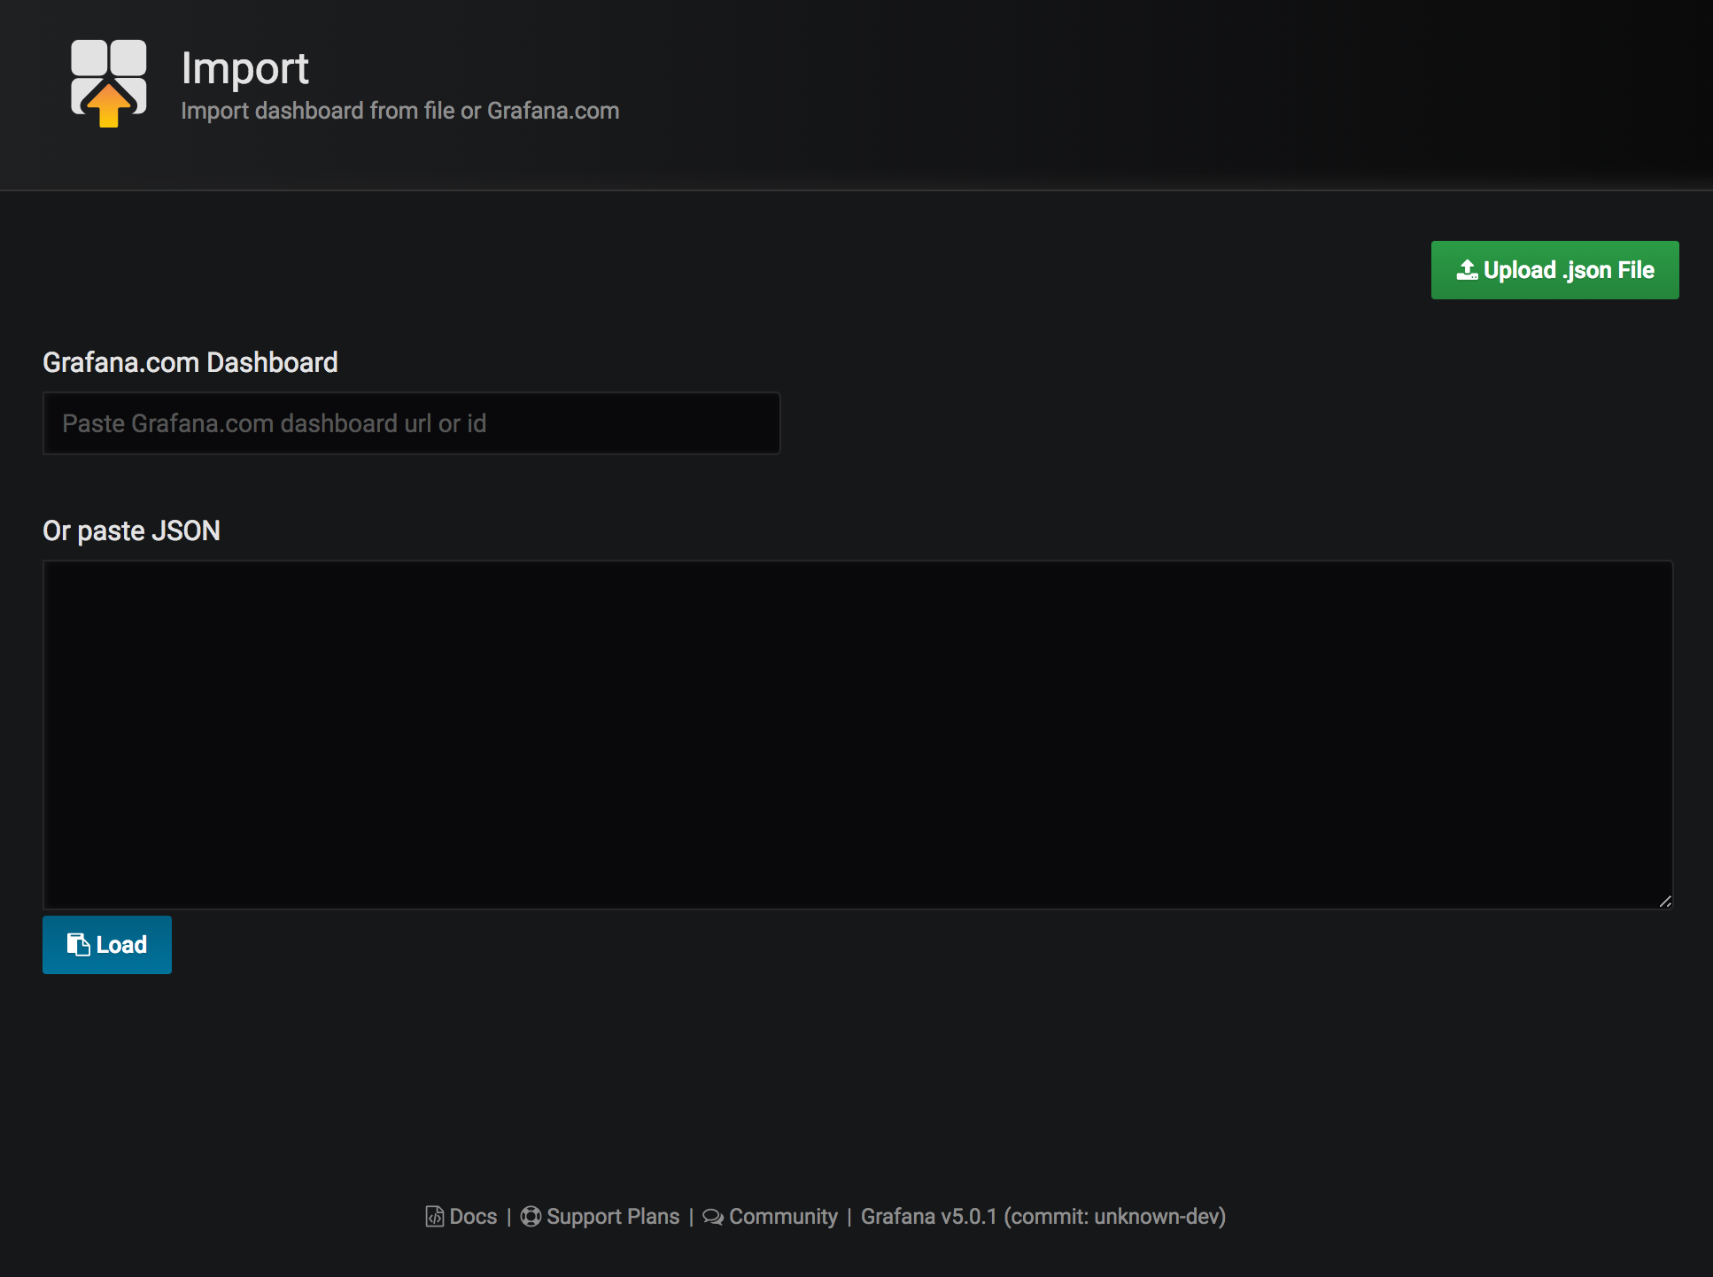
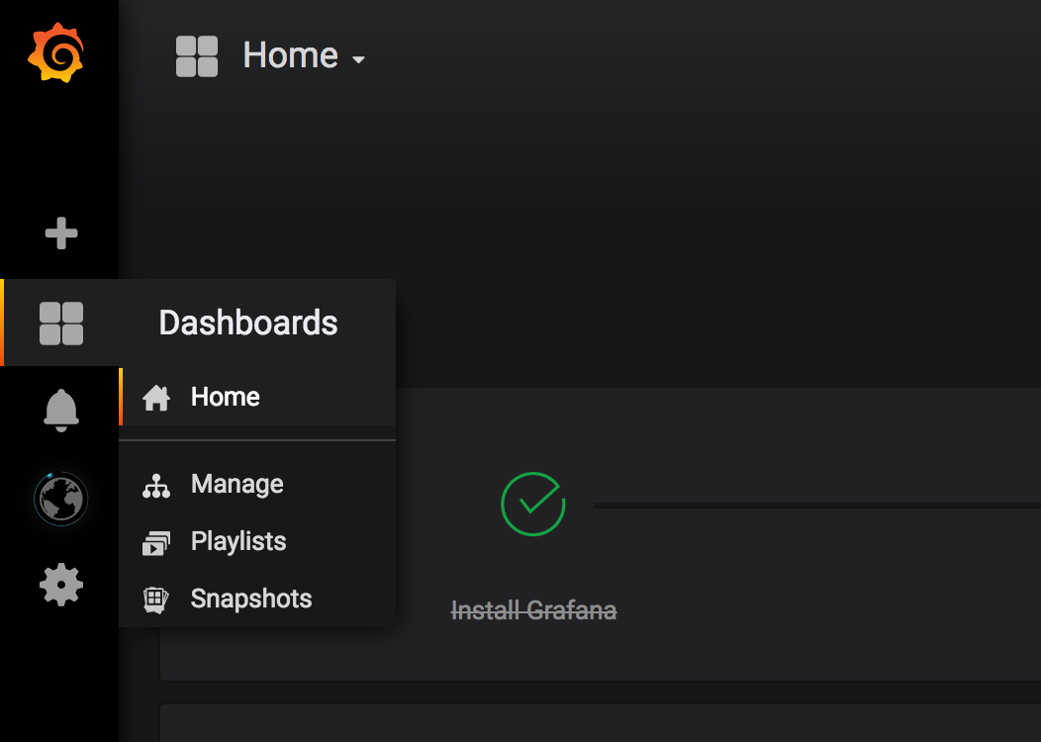
Visualize Data with Grafana
Access the web interface
localhost:3000
Login with admin/admin
Set up data source
User: root
Password: root
Database: air
Create a new dashboard
Add a new graph panel
Start editing panel
Import dashboard from a JSON file
Import air_dashboard.json

Slide 28
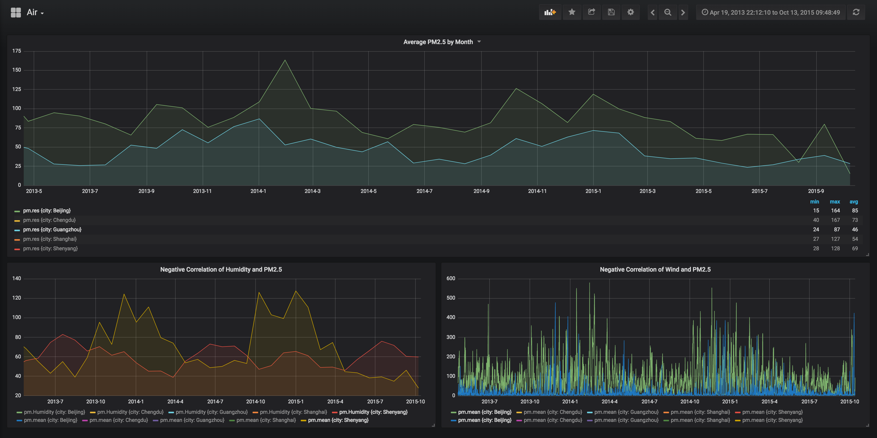
Visualize Data with Grafana

Slide 29
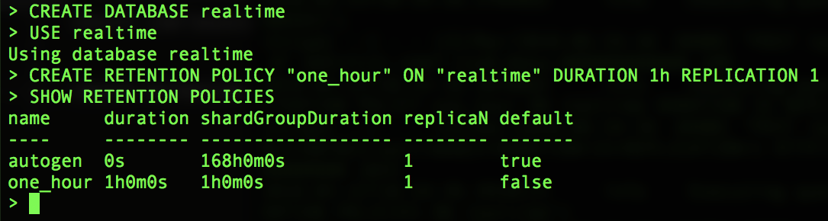
Advanced Functionality - Retention Policy (RP)
Manages how long InfluxDB keeps the data on certain measurement.
After data expires duration set in retention policy, InfluxDB automatically drops the data.
Every time a database is created, InfluxDB generates a default RP called autogen, which has no duration time (data never dropped)
Create a user defined RP
CREATE DATABASE realtime
USE realtime
CREATE RETENTION POLICY "one_hour" ON "realtime" DURATION 1h REPLICATION 1
SHOW RETENTION POLICIES

Slide 30
Advanced Functionality - Continuous Query (CQ)
A query that runs automatically and periodically within a database.
Normally used for automatically down sampling data.
Continuous queries require a function in the SELECT clause and must include a GROUP BY time() clause.
Create a CQ
CREATE CONTINUOUS QUERY "cq_one_min" ON "realtime" BEGIN SELECT mean(data_value) INTO realtime.autogen.realtime_mean FROM realtime.one_hour.realtime GROUP BY time(1m) END
SHOW CONTINUOUS QUERIES
CREATE CONTINUOUS QUERY "cq_one_min" ON "realtime"
BEGIN
SELECT mean(data_value)
INTO realtime.autogen.realtime_mean
FROM realtime.one_hour.realtime
GROUP BY time(1m)
END

Slide 31
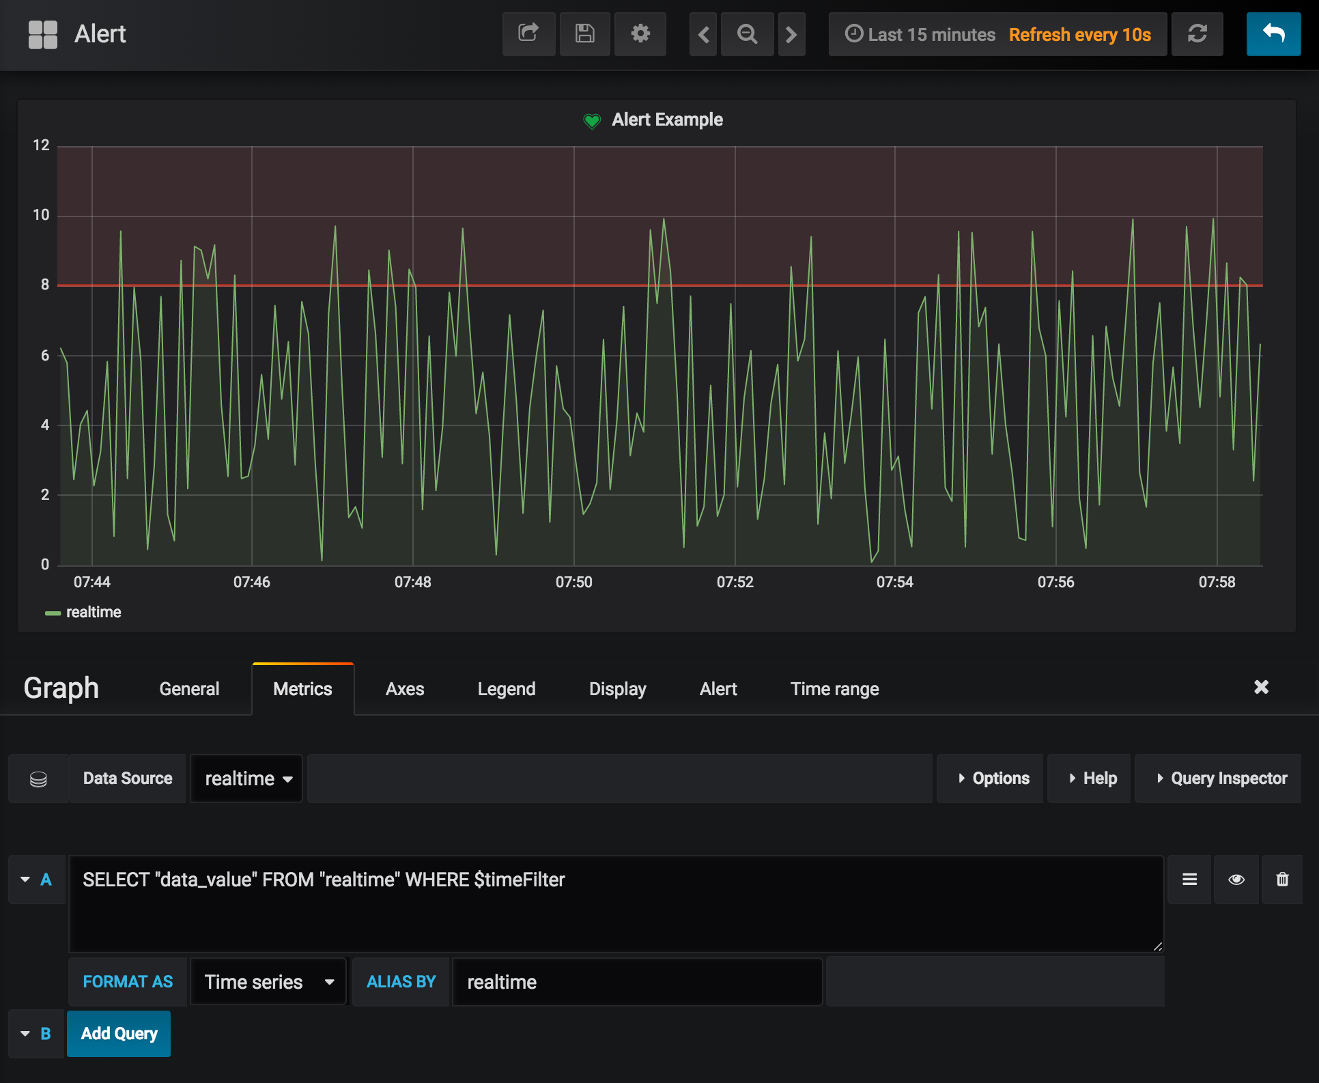
Monitor Realtime Data with Grafana
Run realtime data insert script
pip install influxdb
python scripts/realtime.py
Create a new data source that links to the database realtime
Create a new dashboard
Create panel with query
SELECT "data_value" FROM "realtime" WHERE $timeFilter

Slide 32
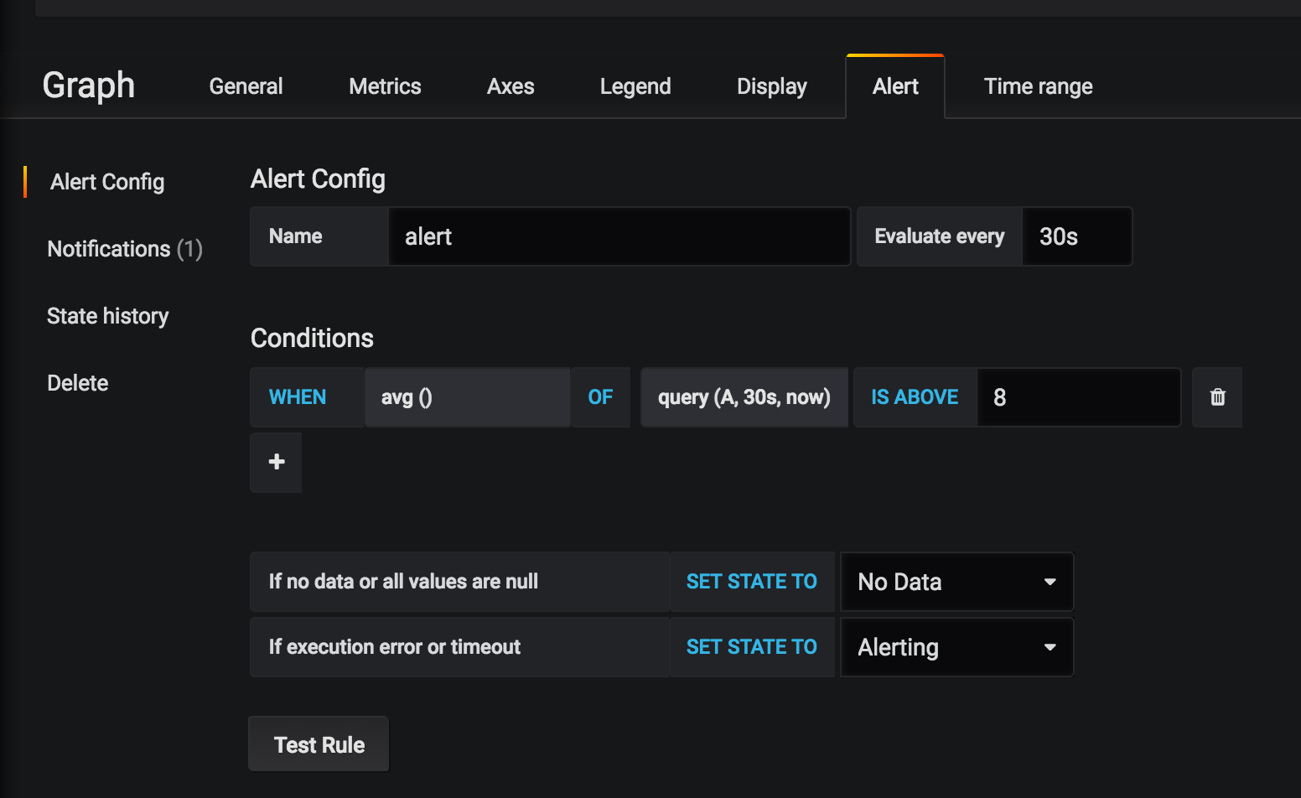
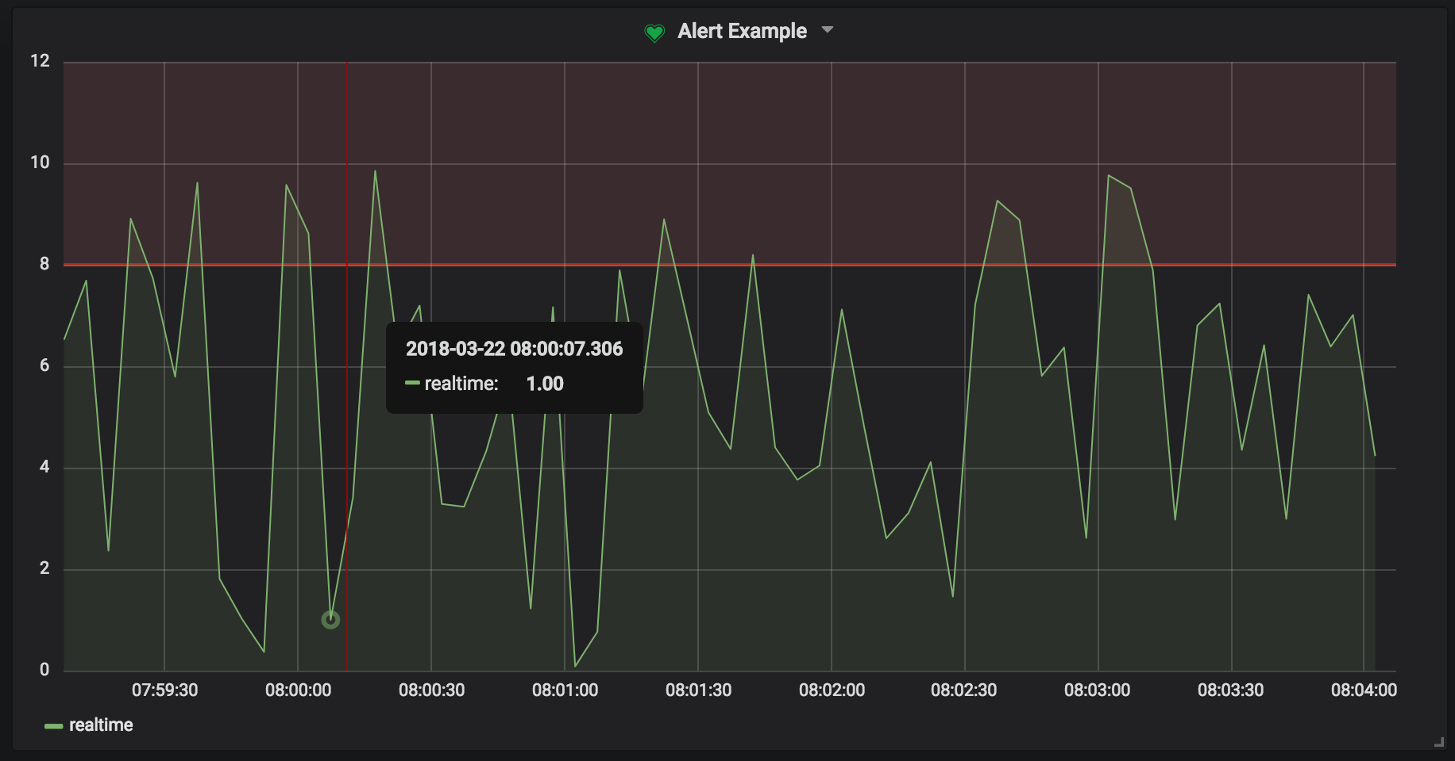
Alerting with Grafana
Edit the Alert tab and be notified by mail if certain criteria has been met
http://docs.grafana.org/alerting/rules/

Slide 33
References
https://docs.influxdata.com/influxdb/v1.5
http://docs.grafana.org/
https://blog.timescale.com/time-series-data-why-and-how-to-use-a-relational-database-instead-of-nosql-d0cd6975e87c
https://blog.timescale.com/what-the-heck-is-time-series-data-and-why-do-i-need-a-time-series-database-dcf3b1b18563

